Slide 1
The Semantic Web:
Ontologies and OWL
Ian Horrocks and Alan Rector

Slide 2
Introduction to the
Semantic Web

Slide 3

History of the Semantic Web
Web was “invented” by Tim Berners-Lee (amongst others), a physicist working at CERN
TBL’s original vision of the Web was much more ambitious than the reality of the existing (syntactic) Web:
TBL (and others) have since been working towards realising this vision, which has become known as the Semantic Web
  E.g., article in May 2001 issue of Scientific American…
“... a goal of the Web was that, if the interaction between person and hypertext could be so intuitive that the machine-readable information space gave an accurate representation of the state of people's thoughts, interactions, and work patterns, then machine analysis could become a very powerful management tool, seeing patterns in our work and facilitating our working together through the typical problems which beset the management of large organizations.”

Slide 4
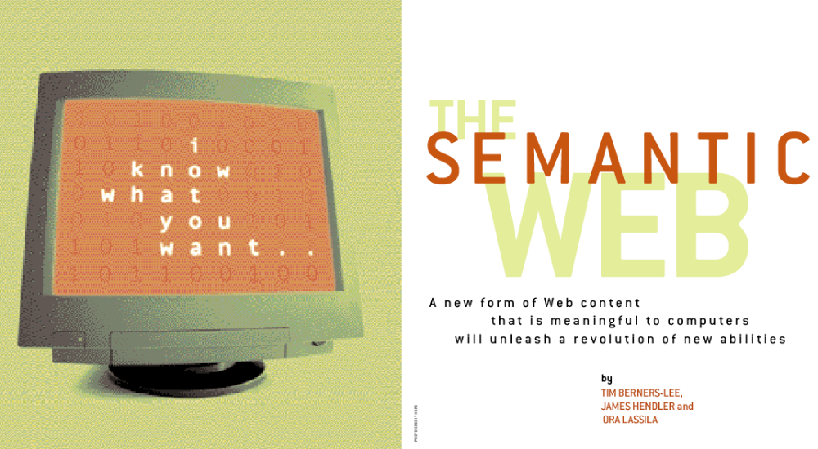
Scientific American, May 2001:
Beware of the Hype

Slide 5
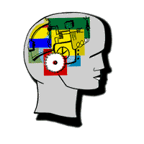
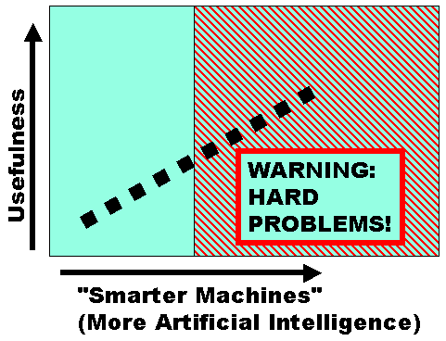
Beware of the Hype
Hype seems to suggest that Semantic Web means: “semantics + web = AI”
  “A new form of Web content that is meaningful to computers will unleash a revolution of new abilities”
More realistic to think of it as meaning: “semantics + web + AI = more useful web”
  Realising the complete “vision” is too hard for now (probably)
  But we can make a start by adding semantic annotation to web resources
Images from Christine Thompson and David Booth

Slide 6
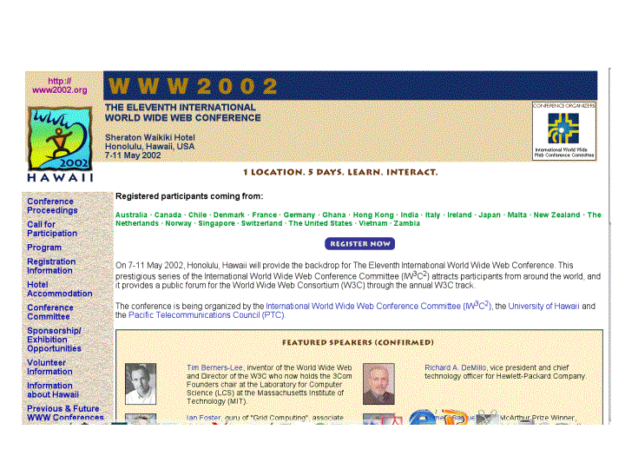
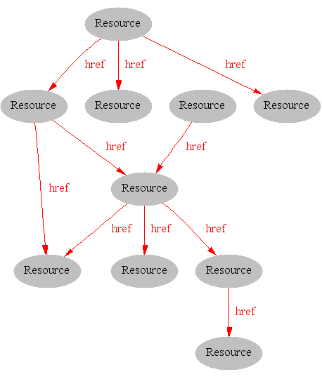
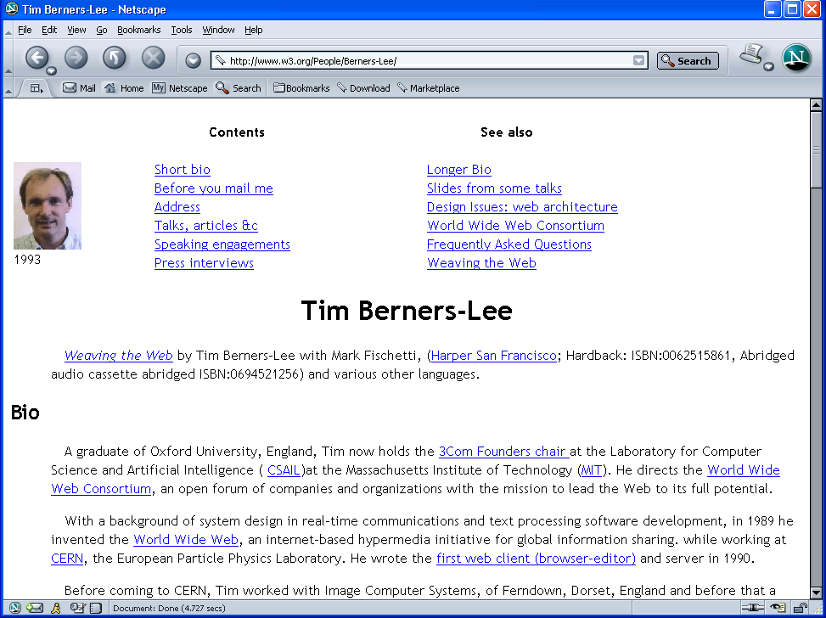
Where we are Today: the Syntactic Web
[Hendler & Miller 02]

Slide 7
The Syntactic Web is…
A hypermedia, a digital library
  A library of documents called (web pages) interconnected by a hypermedia of links
A database, an application platform
  A common portal to applications accessible through web pages, and presenting their results as web pages
A platform for multimedia
  BBC Radio 4 anywhere in the world! Terminator 3 trailers!
A naming scheme
  Unique identity for those documents
A place where computers do the presentation (easy) and people do the linking and interpreting (hard).
Why not get computers to do more of the hard work?
[Goble 03]

Slide 8
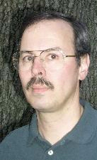

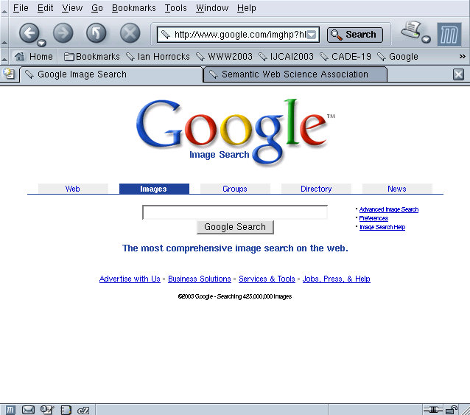
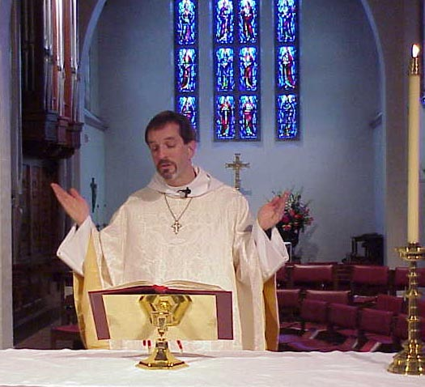

Hard Work using the Syntactic Web…
Find images of Peter Patel-Schneider, Frank van Harmelen and Alan Rector…
Rev. Alan M. Gates, Associate Rector of the Church of the Holy Spirit, Lake Forest, Illinois

Slide 9
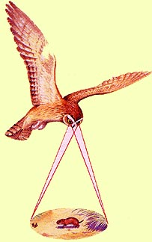
Impossible (?) using the Syntactic Web…
Complex queries involving background knowledge
  Find information about “animals that use sonar but are not either bats or dolphins”
Locating information in data repositories
  Travel enquiries
  Prices of goods and services
  Results of human genome experiments
Finding and using “web services”
  Visualise surface interactions between two proteins
Delegating complex tasks to web “agents”
  Book me a holiday next weekend somewhere warm, not too far away, and where they speak French or English
, e.g., Barn Owl

Slide 10
What is the Problem?
Consider a typical web page:
Markup consists of:
  rendering information (e.g., font size and colour)
  Hyper-links to related content
Semantic content is accessible to humans but not (easily) to computers…

Slide 11
What information can we see…
WWW2002
The eleventh international world wide web conference
Sheraton waikiki hotel
Honolulu, hawaii, USA
7-11 may 2002
1 location 5 days learn interact
Registered participants coming from
australia, canada, chile denmark, france, germany, ghana, hong kong, india, ireland, italy, japan, malta, new zealand, the netherlands, norway, singapore, switzerland, the united kingdom, the united states, vietnam, zaire
Register now
On the 7th May Honolulu will provide the backdrop of the eleventh international world wide web conference. This prestigious event …
Speakers confirmed
Tim berners-lee
Tim is the well known inventor of the Web, …
Ian Foster
Ian is the pioneer of the Grid, the next generation internet …

Slide 12
What information can a machine see…









…


…

…

Slide 13
Solution: XML markup with “meaningful” tags?
<name>
</name>
<location>
</location>
<date></date>
<slogan></slogan>
<participants>
</participants>
<introduction>
…
</introduction>
<speaker></speaker>
<bio></bio>…

Slide 14
But What About…
<conf>
</conf>
<place>
</place>
<date></date>
<slogan></slogan>
<participants>
</participants>
<introduction>
…
</introduction>
<speaker></speaker>
<bio>…

Slide 15
Machine sees…
<>
</>
<>
</>
<></>
<></>
<>
</>
<>
…
</>
<></>
<></>
<></>
<></>

Slide 16
Need to Add “Semantics”
External agreement on meaning of annotations
  E.g., Dublin Core
    Agree on the meaning of a set of annotation tags
  Problems with this approach
    Inflexible
    Limited number of things can be expressed
Use Ontologies to specify meaning of annotations
  Ontologies provide a vocabulary of terms
  New terms can be formed by combining existing ones
  Meaning (semantics) of such terms is formally specified
  Can also specify relationships between terms in multiple ontologies

Slide 17
Ontology: Origins and History
Ontology in Philosophy
  a philosophical discipline—a branch of philosophy that
  deals with the nature and the organisation of reality
Science of Being (Aristotle, Metaphysics, IV, 1)
Tries to answer the questions:
    What characterizes being?
    Eventually, what is being?

Slide 18


Ontology in Linguistics
Concept
Relates to
activates
Form
Referent
Stands for
“Tank“
?
[Ogden, Richards, 1923]

Slide 19
Ontology in Computer Science
An ontology is an engineering artifact:
  It is constituted by a specific vocabulary used to describe a certain reality, plus
  a set of explicit assumptions regarding the intended meaning of the vocabulary.
Thus, an ontology describes a formal specification of a certain domain:
  Shared understanding of a domain of interest
  Formal and machine manipulable model of a domain of interest
“An explicit specification of a conceptualisation” [Gruber93]

Slide 20
Structure of an Ontology
Ontologies typically have two distinct components:
Names for important concepts in the domain
  Elephant is a concept whose members are a kind of animal
  Herbivore is a concept whose members are exactly those animals who eat only plants or parts of plants
  Adult_Elephant is a concept whose members are exactly those elephants whose age is greater than 20 years
Background knowledge/constraints on the domain
  Adult_Elephants weigh at least 2,000 kg
  All Elephants are either African_Elephants or Indian_Elephants
  No individual can be both a Herbivore and a Carnivore

Slide 21
A Semantic Web — First Steps
Make web resources more accessible to automated processes
Extend existing rendering markup with semantic markup
  Metadata annotations that describe content/funtion of web accessible resources
Use Ontologies to provide vocabulary for annotations
  “Formal specification” is accessible to machines
A prerequisite is a standard web ontology language
  Need to agree common syntax before we can share semantics
  Syntactic web based on standards such as HTTP and HTML

Slide 22
Ontology Design and Deployment
Given key role of ontologies in the Semantic Web, it will be essential to provide tools and services to help users:
  Design and maintain high quality ontologies, e.g.:
    Meaningful — all named classes can have instances
    Correct — captured intuitions of domain experts
    Minimally redundant — no unintended synonyms
    Richly axiomatised — (sufficiently) detailed descriptions
  Store (large numbers) of instances of ontology classes, e.g.:
    Annotations from web pages
  Answer queries over ontology classes and instances, e.g.:
    Find more general/specific classes
    Retrieve annotations/pages matching a given description
  Integrate and align multiple ontologies

Slide 23
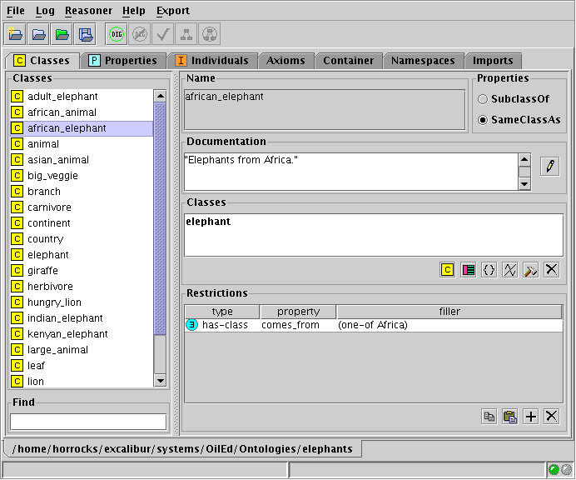
Example Ontology

